Slide 1

Smart Recruitment Assistant
AI Screening System — Benha University Faculty of Computers & Artificial Intelligence
Instructor
About This Project
Abdelrahman Yasser Hussein
This project presents an end-to-end machine learning system designed to assist HR recruiters in identifying candidates who are likely open to a job change. Built using the HR Analytics Job Change dataset, the system leverages HistGradientBoosting to deliver probability-based predictions that support — not replace — human decision-making.
Team Members
Shorouk Yehia Ismail
Sama Tarek Abdelhamed
Shahd Amr Salah
Malak Fayez Kamal
Hager Mohamed Farag
AI Training Program — Benha University | Decision-Support Tool, Not Automated Decision-Maker
79.44%
65.01%
Accuracy
F1 Score
82.05%
19,158
ROC-AUC
Training Records

Slide 2

The Problem & Our Solution
The Challenge
Our Approach
Recruiters face a significant bottleneck when screening large volumes of candidate profiles. Identifying which candidates are genuinely open to a job change is time-consuming, inconsistent, and lacks data-driven prioritization.
A machine-learning screening assistant that analyzes candidate information and surfaces the most promising profiles for recruiter review.
Recruiters review large numbers of candidate profiles manually
Identifying candidates open to job change is time-consuming
Manual screening lacks data-driven prioritization
Analyzes candidate information across multiple dimensions
Predicts likelihood of job-change interest
Provides probability-based confidence scores
Helps recruiters prioritize profiles efficiently
Supports — rather than replaces — human decisions
System Flow
Candidate Profile
ML Model
Prediction + Confidence
Recruiter Review
The pipeline transforms raw candidate data into actionable, probability-ranked outputs that empower recruiters to make faster, more informed decisions — while keeping humans firmly in control of final hiring choices.
[SCREENSHOT 1] System workflow / candidate input interface — to be embedded here.

Slide 3
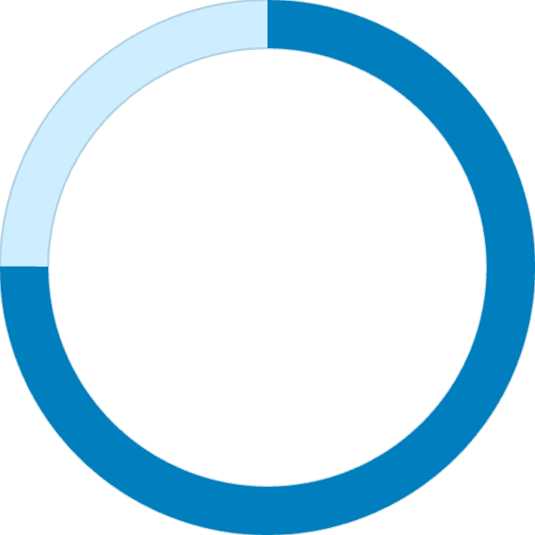
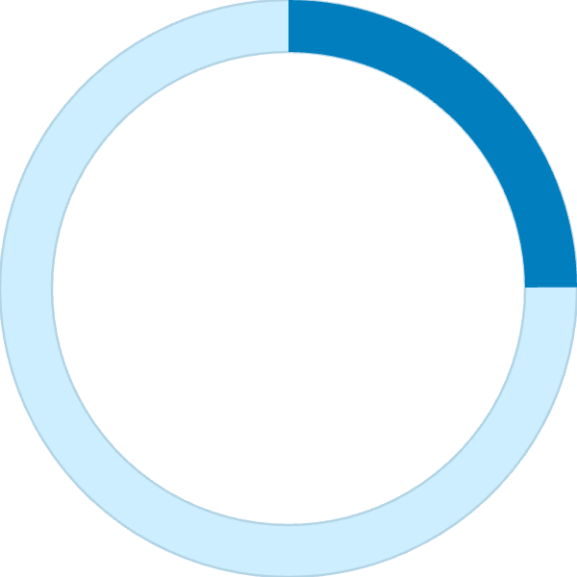
Dataset & Preprocessing
HR Analytics Job Change Dataset
Preprocessing Pipeline
19,158
2,129
01
Missing Value Handling
Training Records
Test Records
Imputation strategies applied per feature type
Binary classification target: whether a candidate is looking for a job change or not.
02
Experience Conversion
Text-based experience fields converted to numeric
75.07%
24.93%
03
Ordinal & Frequency Encoding
Ordinal encoding for ranked categories; city frequency encoding
04
Class 0
Class 1
One-Hot Encoding & Scaling
Not looking for a change
Looking for a change
Nominal features one-hot encoded; standard scaling applied
The dataset is imbalanced, which directly influenced model selection and evaluation strategy.
Key Practices
Training-only fitting prevents data leakage
Stratified 80/20 train-test split
Fixed random_state = 42 for reproducibility

Slide 4

Machine Learning Models
Four Models Compared Under Identical Conditions
1
2
Logistic Regression
Random Forest
Interpretable linear baseline. Class imbalance handled via class_weight="balanced".
Tree-based ensemble with bagging. Class imbalance handled via class_weight="balanced".
3
4
ExtraTrees
HistGradientBoosting
Randomized tree ensemble with extra randomization. Class imbalance handled via class_weight="balanced".
Histogram-based gradient boosting. Class imbalance handled via balanced sample weights. ← Selected Model
Handling Class Imbalance
Fair Comparison Protocol
Because only 24.93% of candidates are labeled as job-seekers, all four models were configured to account for class imbalance — either through class_weight="balanced" or balanced sample weights — ensuring the minority class received appropriate attention during training.
Same preprocessing pipeline applied to all models
Same stratified train/test split used across all experiments
Same evaluation metrics computed for every model
Accuracy alone was not used as the selection criterion due to class imbalance

Slide 5
Model Performance Comparison
Which Model Performed Best?
Model
Accuracy
F1 Score
Recall
ROC-AUC
Selection Score
Logistic Regression
75.08%
60.97%
78.12%
80.28%
73.86%
Random Forest
78.16%
51.59%
46.70%
80.03%
61.49%
ExtraTrees
78.55%
63.27%
74.14%
80.23%
73.68%
HistGradientBoosting ✓
79.44%
65.01%
76.65%
82.05%
75.55%
Selection Score Formula
Why HistGradientBoosting Wins
Selection Score = mean of Recall + F1 + Balanced Accuracy + ROC-AUC
Accuracy alone was not used as the selection criterion because the target variable is imbalanced. The composite Selection Score rewards models that perform well across all dimensions of classification quality.
Highest accuracy at 79.44%
Best F1 Score at 65.01% — balances precision and recall
Best ROC-AUC at 82.05% — strongest discriminative power
Highest composite Selection Score at 75.55%

Slide 6


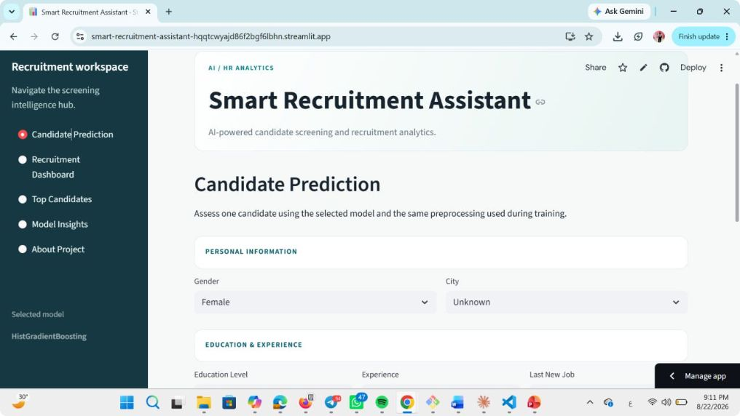
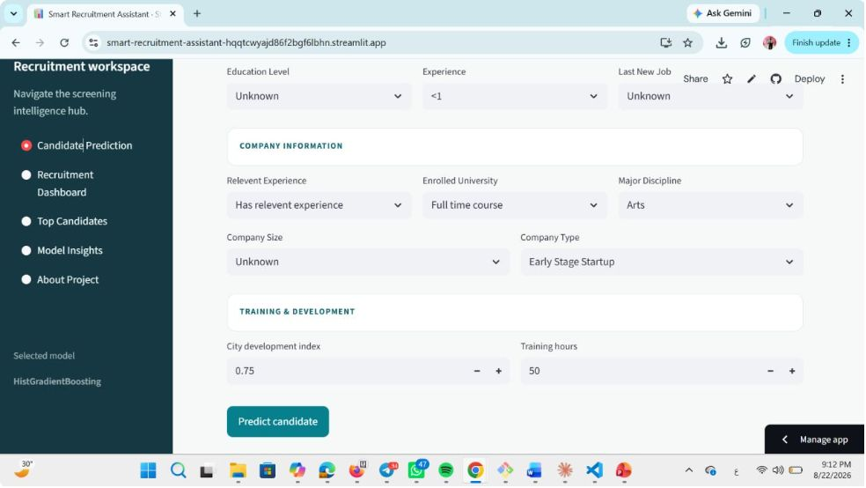
The Final System: Streamlit Dashboard
HistGradientBoosting
Preprocessing Pipeline
Candidate Profile
Dashboard Features
Production Consistency
Candidate Prediction
Recruitment Dashboard
Trained preprocessing artifacts and the final model are saved and reused during inference, ensuring that the exact same transformations applied during training are applied at prediction time.
This eliminates training/inference skew — a common source of silent model degradation in production ML systems.
Individual candidate screening with probability output
High-level overview and analytics across candidate pool
Top Candidates
Model Insights
Technology Stack
Ranked list sorted by job-change likelihood score
Feature importance and explainability visualizations
Streamlit — interactive web dashboard
scikit-learn — model training & preprocessing
HistGradientBoostingClassifier — core prediction engine
Serialized pipeline artifacts — inference consistency
About Project
System documentation and methodology overview

Slide 7
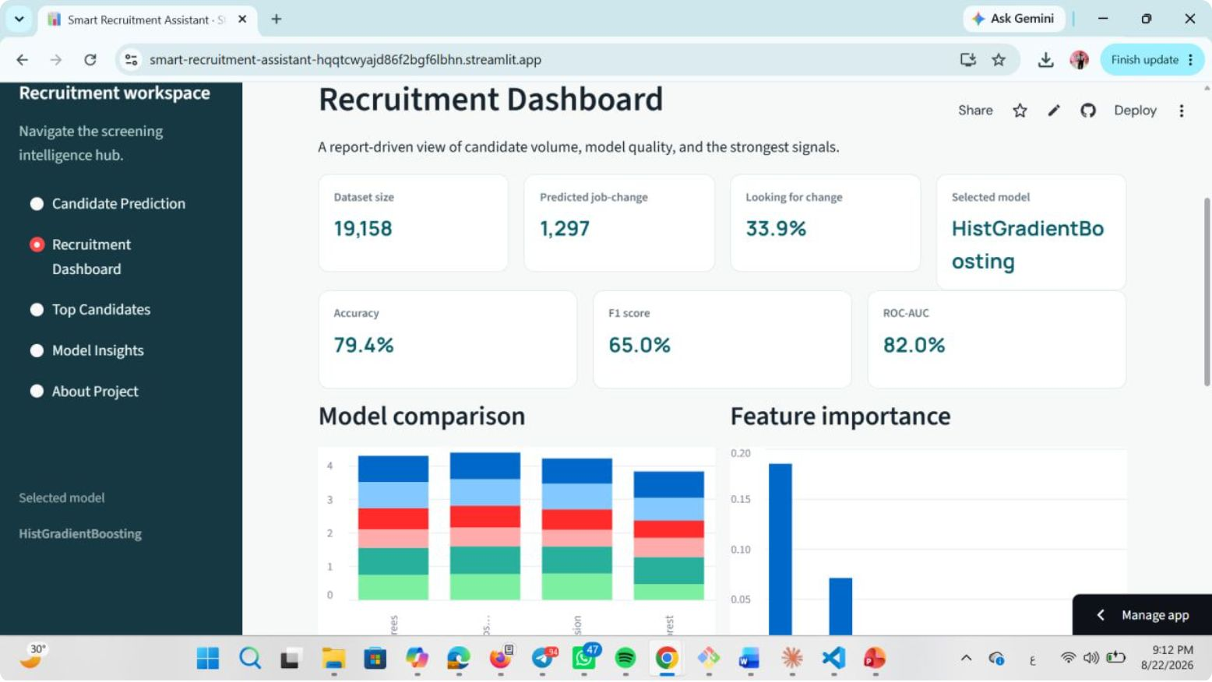
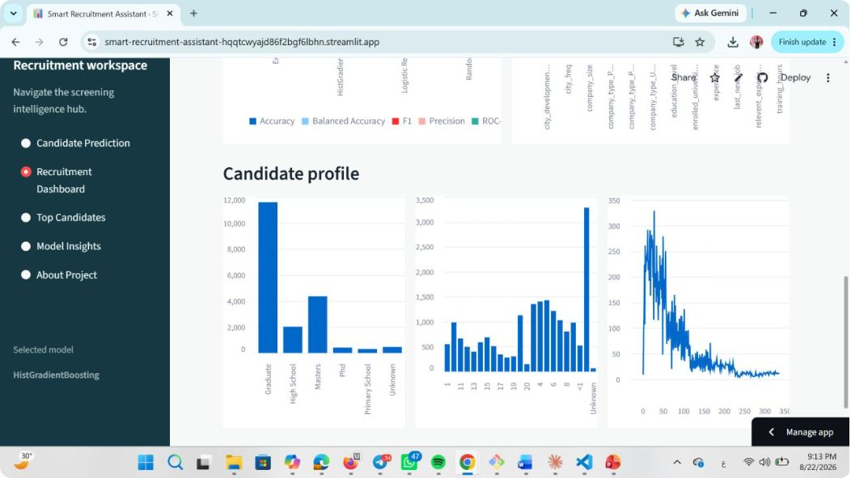
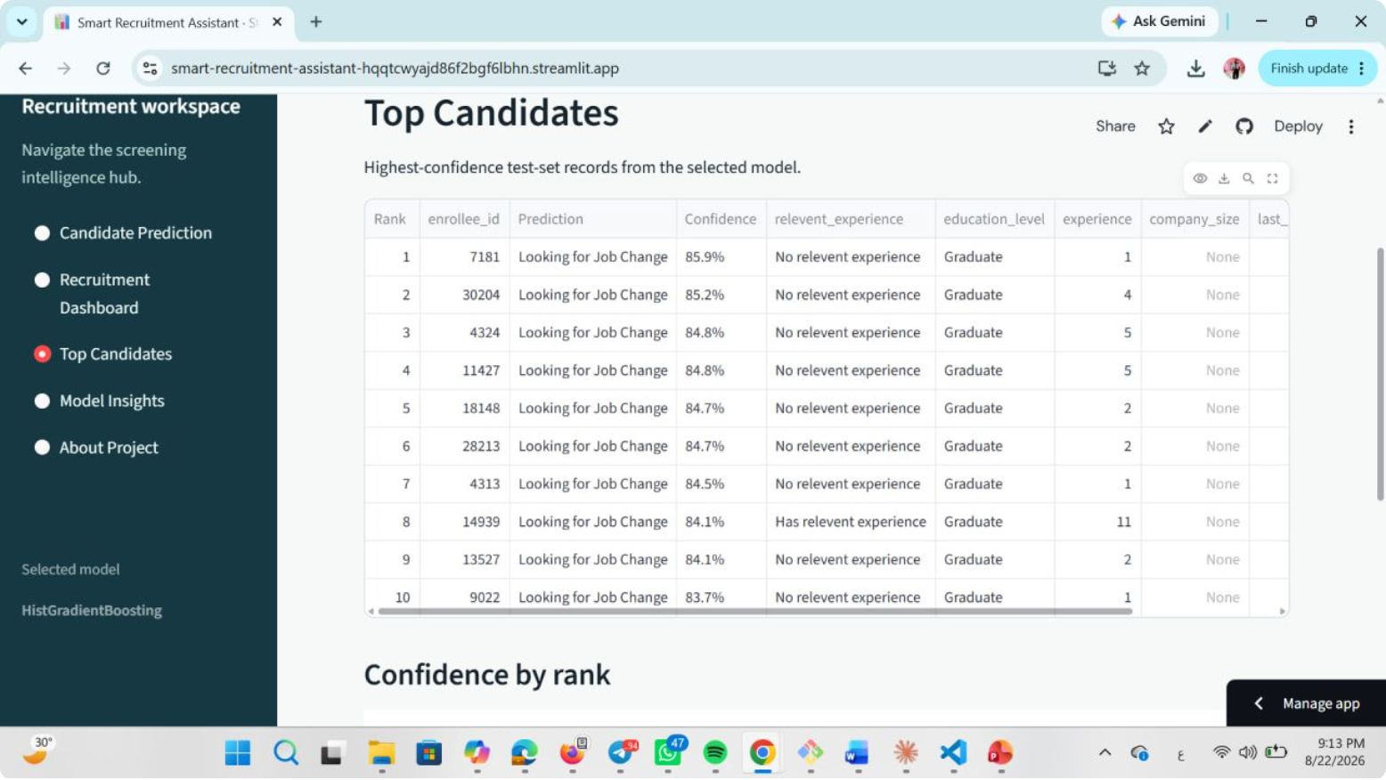
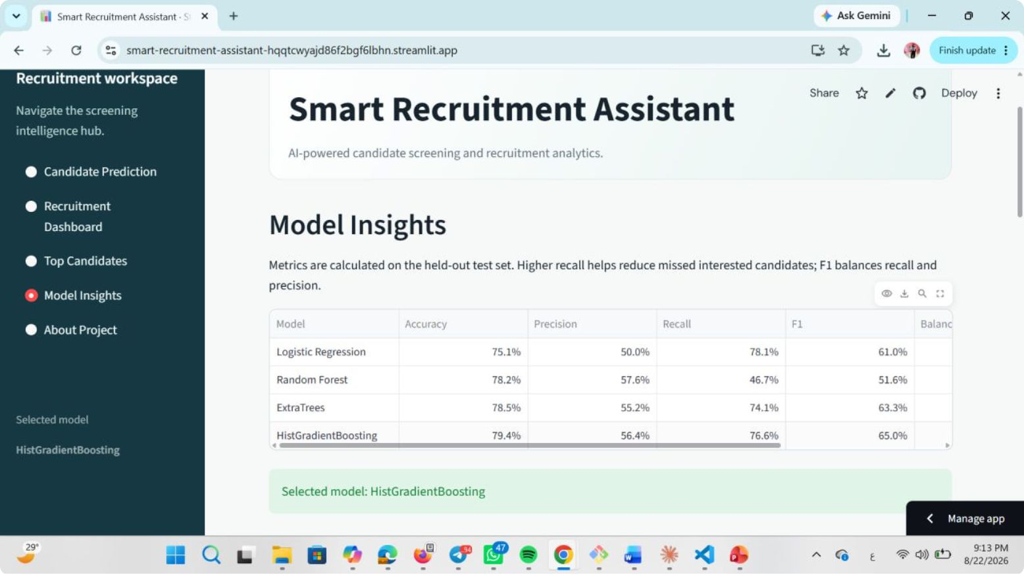

Slide 8

Model Explainability
Why Did the Model Make This Prediction?
Logistic Regression Insights
HistGradientBoosting Insights
Logistic Regression provides direct coefficient-based interpretability, making it a useful reference model for understanding feature directionality.
Because gradient boosting models are non-linear and ensemble-based, standard coefficient analysis does not apply. Instead, the system uses permutation importance to measure each feature's predictive contribution.
Positive coefficients → increase estimated class-1 likelihood (candidate is job-seeking)
Negative coefficients → decrease estimated class-1 likelihood
Feature importance measured using permutation importance with ROC-AUC
Shows predictive contribution, not causation
Features that, when shuffled, most reduce ROC-AUC are ranked as most important
Coefficients offer a transparent, linear view of how each feature pushes the prediction in either direction.
Transparency in Screening
Recruiter Understanding
Informed Decisions
Predictive ≠ Causal
Recruiters can see which candidate attributes drive each prediction, not just the final score.
Explainability supports informed, accountable decision-making rather than blind trust in model outputs.
Feature importance reflects statistical association with the target — not a causal claim about candidate behavior.
[SCREENSHOT 6] Feature importance / model insights visualization — to be embedded here.

Slide 9
Results, Limitations & Responsible AI
What We Achieved
Responsible AI Commitment
79.44%
65.01%
The system is a decision-support tool.
It should prioritize candidates for review — NOT automatically hire or reject candidates. Every prediction is a signal to inform human judgment, not a substitute for it.
Accuracy
F1 Score
82.05%
75.55%
Recruiters remain the final decision-makers. The model surfaces candidates worth reviewing — the human evaluates them.
ROC-AUC
Selection Score
Current Limitations
No Cross-Validation
No Hyperparameter Tuning
No Probability Calibration
Static Dataset
Single stratified holdout split only — results may vary across different data partitions
Default or manually set parameters — systematic optimization not yet performed
Predicted probabilities may not be well-calibrated for real-world use
Historical data only — model may not reflect current labor market dynamics
No Fairness Audit
No Public Deployment
Subgroup performance and potential bias have not yet been formally evaluated
System is not yet publicly deployed — security and reliability review required first

Slide 10

Conclusion & Future Work
What We Built
Future Improvements
A complete, end-to-end ML workflow — from raw data to a deployed screening assistant:
Hyperparameter Optimization & Cross-Validation
Systematic tuning with k-fold CV for more robust performance estimates
01
Data & Preprocessing
Better Feature Engineering
19,158 records, stratified split, leakage-free pipeline
Domain-informed features to improve predictive signal
02
Probability Calibration
Model Comparison
Platt scaling or isotonic regression for reliable confidence scores
Four models evaluated on composite Selection Score
Fairness & Subgroup Analysis
03
Formal audit across demographic subgroups to detect and mitigate bias
Best Model Selected
Stronger Explainability
HistGradientBoosting — 79.44% Accuracy | 65.01% F1 | 82.05% ROC-AUC
SHAP values for instance-level, model-agnostic explanations
04
Public Deployment
Explainability & Application
After security review and reliability validation
Permutation importance + Streamlit dashboard for recruiters
"AI-assisted screening, with humans still in the loop."

